Slide 1
Malignent Comment CASE STUDY
By poonam kocheta

Slide 2
Feature description

Slide 3

Data visualization

Slide 4
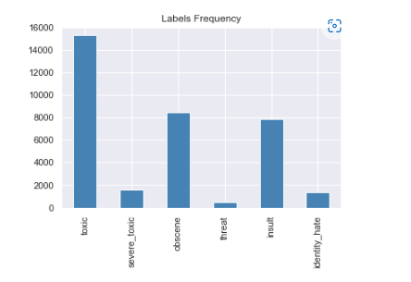

Slide 5
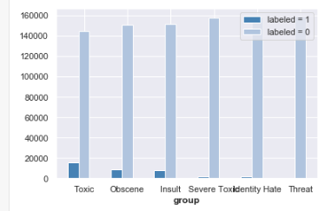

Slide 7
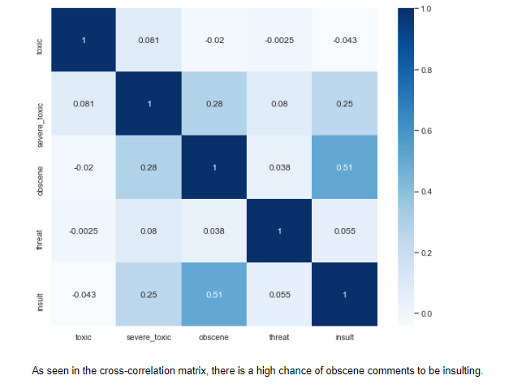

Slide 8
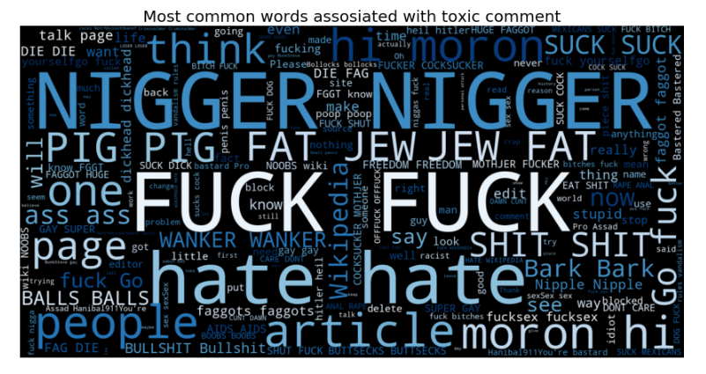

Slide 9
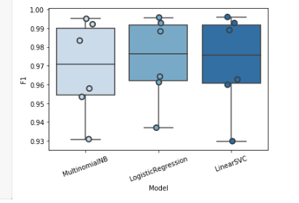

Slide 10
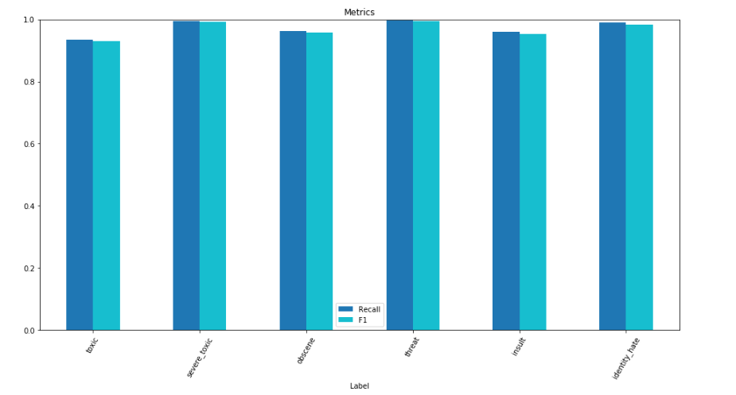
Multinomial Naive Bayes regression

Slide 11
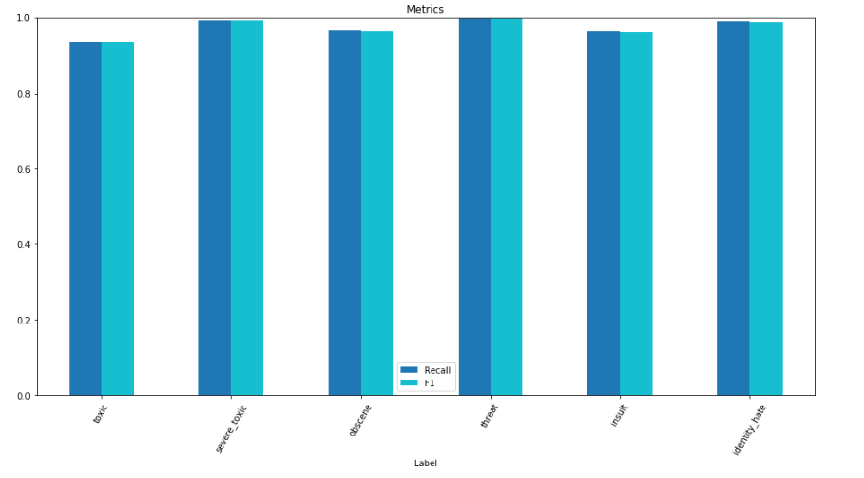
Logistic regression

Slide 12
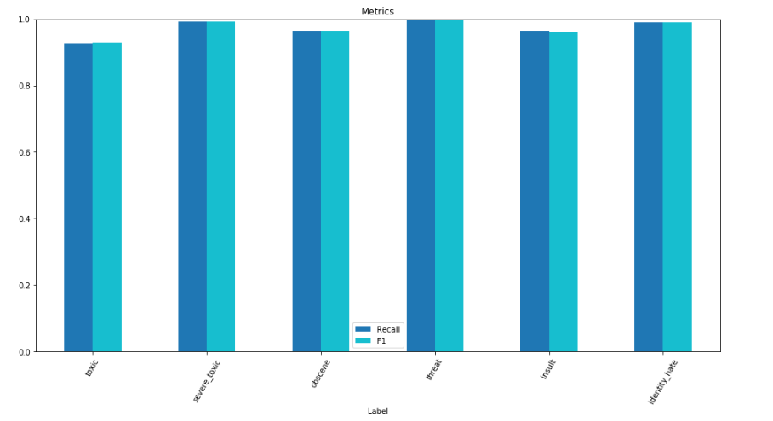
Linear SVC

Slide 13
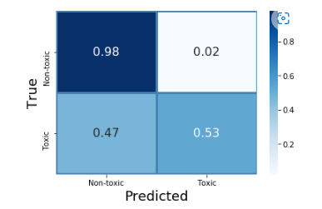
Multinomial Naïve Bayer

Slide 14
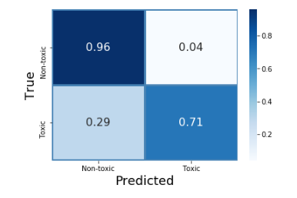
Logistic Regression

Slide 15
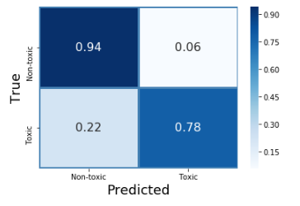
Linear SVC

Slide 16


CONCLUSION

Slide 17
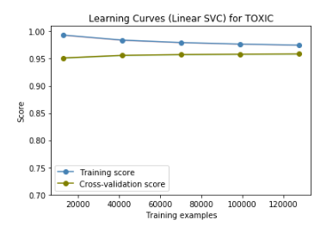

Slide 18
Thank you

